Slide 1
CaptCha Cracking
102062309 王暉博 102062221 史芳瑜

Slide 2
Outline
Introduction to OCR
How to crack CAPTCHA?
Image Denoising
Building Disjoint Sets
Image Recognition
Demo

Slide 3
Outline
Introduction to OCR
How to crack CAPTCHA?
Image Denoising
Building Disjoint Sets
Image Recognition
Demo

Slide 4
What IS OCR?
OCR = Optical Character Recognition(光學字元辨識)
A technology that allows you to convert scanned images of text into plain text
Our program is an implementation of OCR

Slide 5
Outline
Introduction to OCR
How to crack CAPTCHA?
Image Denoising
Building Disjoint Sets
Image Recognition
Demo

Slide 6




Image denoising
Original Image
Gray Scale Image
Image Denoising
Image Binarization

Slide 7
Outline
Introduction to OCR
How to crack CAPTCHA?
Image Denoising
Building Disjoint Sets
Image Recognition
Demo

Slide 8
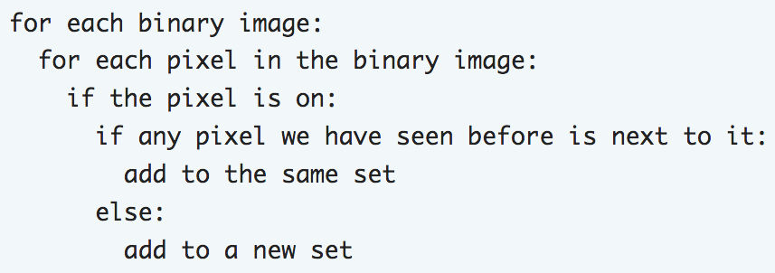
Building Disjoint sets

Slide 9
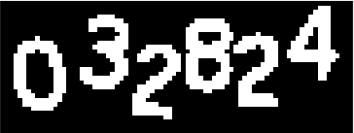
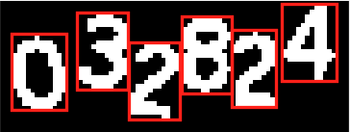






Building Disjoint Sets
Original Image
Crop Image

Slide 10
Building disjoint sets
It is a simple task when every number is apart from each other
How about connected numbers?

Slide 11

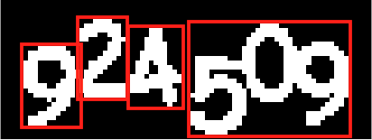


BUILDING DISJOINT SETS
2-connected components
3-connected components
4-connected components
5-connected components

Slide 12
BUILDING DISJOINT SETS
According to our observation, every number’s gray value is smaller than their right side number; that is, the gray values of the numbers grow gradually from the left side to the right

Slide 13
Building disjoint sets
Therefore, by knowing which connected component it is, we can obtain the threshold(s) using Otsu’s method.
The cropped number may not be neat, so we erode it and dilate it, trying to reconstruct the number.

Slide 14
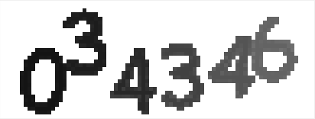

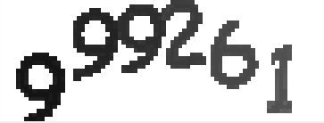
BUILDING DISJOINT SETS

Slide 15
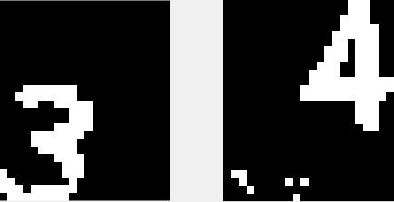

Building disjoint sets
Before
After

Slide 16
Outline
Introduction to OCR
How to crack CAPTCHA?
Image Denoising
Building Disjoint Sets
Image Recognition
Demo

Slide 17










Image recognition
First of all, we build our training set

Slide 18



IMAGE RECOGNITION
Next, rotate the number we want to identify
Then, calculate the probability of each number
Finally, we get the answer ☺
Original
Rotate 10º
Rotate -10º

Slide 19
Demo time

